Slide 1
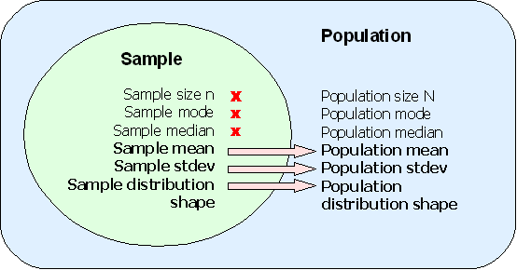
Estimation of a Population mean

Slide 2
Point and Interval Estimates
A point estimate is a single number,
a confidence interval provides additional information about the variability of the estimate
Lower
Confidence
Limit
Upper
Confidence
Limit
Point Estimate
Width of
confidence interval

Slide 3
Point Estimates
We can estimate a
Population Parameter …
with a Sample Statistic
(a Point Estimate)
Mean
μ
X

Slide 4
Confidence Intervals
How much uncertainty is associated with a point estimate of a population parameter?
An interval estimate provides more information about a population characteristic than does a point estimate.
Such interval estimates are called confidence intervals.

Slide 5
Confidence Interval Estimate
An interval gives a range of values:
Takes into consideration variation in sample statistics from sample to sample
Based on observations from 1 sample
Gives information about closeness to unknown population parameters
Stated in terms of level of confidence
e.g. 95% confident, 99% confident
Can never be 100% confident
Chap 8-5

Slide 6
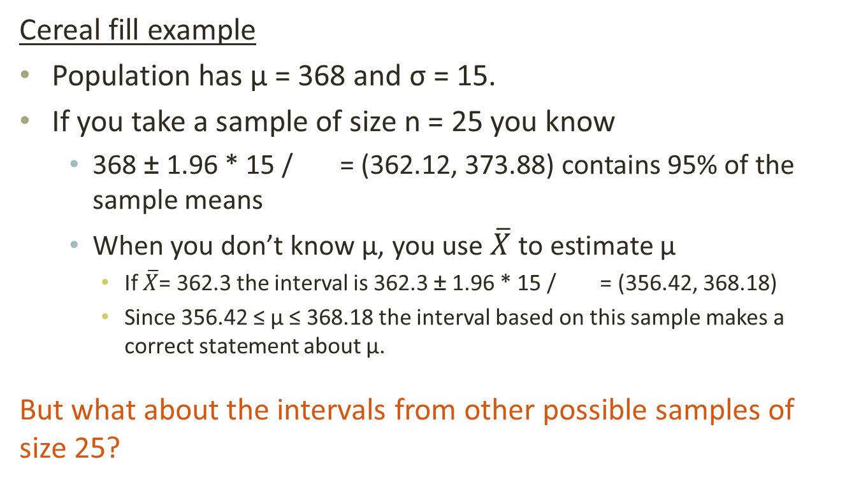
Confidence Interval Example
Cereal fill example
Population has µ = 368 and σ = 15.
If you take a sample of size n = 25 you know
368 ± 1.96 * 15 / = (362.12, 373.88) contains 95% of the sample means
When you don’t know µ, you use $\overline{X}$ to estimate µ
If $\overline{X}$= 362.3 the interval is 362.3 ± 1.96 * 15 / = (356.42, 368.18)
Since 356.42 ≤ µ ≤ 368.18 the interval based on this sample makes a correct statement about µ.
But what about the intervals from other possible samples of size 25?

Slide 7
Confidence Interval Example
(continued)
Sample # | X | Lower Limit | Upper Limit | Contain µ?
1 | 362.30 | 356.42 | 368.18 | Yes
2 | 369.50 | 363.62 | 375.38 | Yes
3 | 360.00 | 354.12 | 355.88 | No
4 | 362.12 | 356.24 | 368.00 | Yes
5 | 373.88 | 368.00 | 379.76 | Yes

Slide 8
Confidence Interval Example
(continued)
In practice you only take one sample of size n
In practice you do not know µ so you do not know if the interval actually contains µ
However, you do know that 95% of the intervals formed in this manner will contain µ
Thus, based on the one sample you actually selected, you can be 95% confident your interval will contain µ (this is a 95% confidence interval)
Note: 95% confidence is based on the fact that we used Z = 1.96.

Slide 9
Estimation Process
I am 95% confident that μ is between 40 & 60.
Random Sample
Population
Mean
X = 50
(mean, μ, is unknown)
Sample

Slide 10
General Formula
The general formula for all confidence intervals is:
Point Estimate ± (Critical Value)(Standard Error)
Where:
Point Estimate is the sample statistic estimating the population parameter of interest
Critical Value is a table value based on the sampling distribution of the point estimate and the desired confidence level
Standard Error is the standard deviation of the point estimate
Chap 8-10

Slide 11
Confidence Level
Confidence Level
Confidence the interval will contain the unknown population parameter
A percentage (less than 100%)
Chap 8-11

Slide 12
Confidence Level, (1-α)
(continued)
Suppose confidence level = 95%
Also written (1 - α) = 0.95, (so α = 0.05)
A relative frequency interpretation:
95% of all the confidence intervals that can be constructed will contain the unknown true parameter
A specific interval either will contain or will not contain the true parameter
No probability involved in a specific interval
Chap 8-12

Slide 13
Finding the Critical Value, Z_{α/2}
Consider a 95% confidence interval:
Z units:
Z_{α/2} = -1.96
0
Z_{α/2} = 1.96
X units:
Lower
Confidence
Limit
Upper
Confidence
Limit
Point Estimate
Point Estimate
Chap 8-13

Slide 14
Common Levels of Confidence
Commonly used confidence levels are 90%, 95%, and 99%
Confidence Coefficient,
Confidence Level
Z_{α/2} value
80%
90%
95%
98%
99%
99.8%
99.9%
0.80
0.90
0.95
0.98
0.99
0.998
0.999
1.28
1.645
1.96
2.33
2.58
3.08
3.27

Slide 15
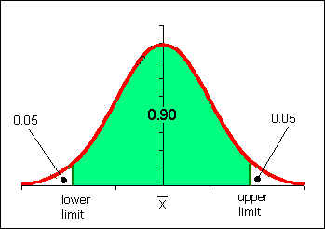
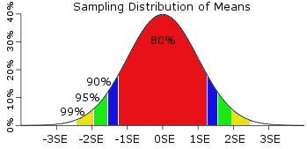
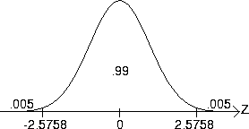
Confidence Interval
What can you infer above the following diagrams?

Slide 16
Intervals and Level of Confidence
Sampling Distribution of the Mean
x
Intervals extend from
to
x₁
(1-α)x100% of intervals constructed contain μ;
(α)x100% do not.
x₂
Confidence Intervals

Slide 17

Example
A sample of 11 circuits from a large normal population has a mean resistance of 2.20 ohms. We know from past testing that the population standard deviation is 0.35 ohms.
Determine a 95% confidence interval for the true mean resistance of the population.

Slide 18

Example
(continued)
A sample of 11 circuits from a large normal population has a mean resistance of 2.20 ohms. We know from past testing that the population standard deviation is 0.35 ohms.
Solution:

Slide 19
Interpretation
We are 95% confident that the true mean resistance is between 1.9932 and 2.4068 ohms
Although the true mean may or may not be in this interval, 95% of intervals formed in this manner will contain the true mean

Slide 20
Confidence Intervals
Confidence
Intervals
Population
Mean
Population
Proportion
σ Known
σ Unknown

Slide 21
Do You Ever Truly Know σ?
Probably not!
In virtually all real world business situations, σ is not known.
If there is a situation where σ is known, then µ is also unknown (since to calculate σ you need to know µ.)
If you truly know µ there would be no need to gather a sample to estimate it.

Slide 22
Confidence Interval for μ (σ Unknown)
If the population standard deviation σ is unknown, we can substitute the sample standard deviation, S
This introduces extra uncertainty, since S is variable from sample to sample
So we use the t distribution instead of the normal distribution

Slide 23
Confidence Interval for μ (σ Unknown)
(continued)
Assumptions
Population standard deviation is unknown
Population is normally distributed
If population is not normal, use large sample
Use Student’s t Distribution
Confidence Interval Estimate:
(where t_{α/2} is the critical value of the t distribution with n -1 degrees of freedom and an area of α/2 in each tail)

Slide 24
Student’s t Distribution
The t is a family of distributions
The t_{α/2} value depends on degrees of freedom (d.f.)
Number of observations that are free to vary after sample mean has been calculated
d.f. = n - 1

Slide 25
Degrees of Freedom (df)
Idea: Number of observations that are free to vary
after sample mean has been calculated
Example: Suppose the mean of 3 numbers is 8.0
Let X₁ = 7
Let X₂ = 8
What is X₃?
If the mean of these three values is 8.0,
then X₃ must be 9
(i.e., X₃ is not free to vary)
Here, n = 3, so degrees of freedom = n – 1 = 3 – 1 = 2
(2 values can be any numbers, but the third is not free to vary for a given mean)

Slide 26
Student’s t Distribution
Note: t Z as n increases
Standard Normal
(t with df = ∞)
t (df = 13)
t-distributions are bell-shaped and symmetric, but have ‘fatter’ tails than the normal
t (df = 5)
0

Slide 27
Student’s t Table
Upper Tail Area
Let: n = 3 df = n - 1 = 2 α = 0.10 α/2 = 0.05
df
.10
.05
.025
1
3.078
6.314
12.706
2
1.886
2.920
4.303
3
1.638
2.353
3.182
The body of the table contains t values, not probabilities
0
2.920

Slide 28
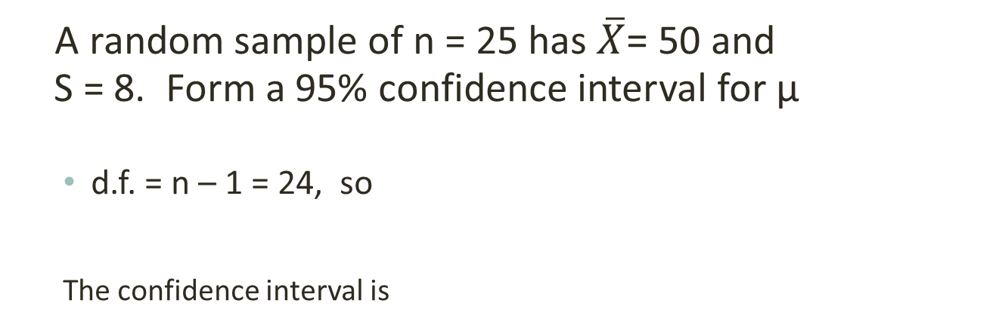
Example of t distribution confidence interval
A random sample of n = 25 has $\overline{X}$= 50 and
S = 8. Form a 95% confidence interval for μ
d.f. = n – 1 = 24, so
The confidence interval is
46.6976 ≤ μ ≤ 53.3024

Slide 29
Example of t distribution confidence interval
(continued)
Interpreting this interval requires the assumption that the population you are sampling from is approximately a normal distribution (especially since n is only 25).
This condition can be checked by creating a:
Normal probability plot or
Boxplot

